Slide 1
SQL Portfolio Project - Data Bank
Extension Request

Slide 2

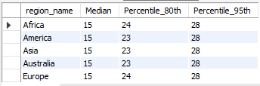
Data Bank providing world-leading security features
Here the days on average customers are reallocated to a different node and their percentile vales are shown.
This dynamic approach makes it harder for attackers to target specific nodes consistently, thus increasing the overall security of the infrastructure.
Regular reallocation of customers to different nodes can help detect anomalous behavior or unauthorized access attempts more effectively.

Slide 3

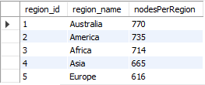
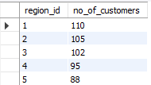
Data Bank providing world-leading security features
Unique nodes protecting the infrastructure from unauthorized access.
Nodes per region serve as fundamental building blocks in Data Bank's security architecture, providing a distributed, resilient, and adaptable framework for safeguarding sensitive data and managing security risks effectively.
Distributing customers across regions help in improving security.

Slide 4
Data Allocation
Option 1: data is allocated based off the amount of money at the end of the previous month can be estimated by
Customer balance at the end of each month
Option 2: data is allocated on the average amount of money kept in the account in the previous 30 days can be estimated by
Minimum, average and maximum values of the running balance for each customer
Option 3: data is updated real-time can be estimated by
Running customer balance column that includes the impact each transaction
Minimum, average and maximum values of the running balance for each customer

